Slide 1
Lecture 9: Incentive Design: Financial Incentives
Instructor: Chien-Ju (CJ) Ho

Slide 2
Logistics: Assignments
Assignment 2: Due this Friday
Assignment 3: Due Oct 13 (Wed) Oct 17 (Monday)
In observation of the fall break
You are encouraged to discuss with others
However, you MUST write down the solution entirely on your own

Slide 3
Logistics: Project
Project proposal:
Every person should be able to see comments on Gradescope as long as you include all teammates in the interface as required
Most comments are about what I expect to see for milestone 1
If you want to talk more
My office hour is 5:30pm-6:30pm Thursdays in McKelvey 2010A

Slide 4
Logistics: Project
Project milestone 1: Due Oct 14 (Fri)
Initial literature survey (know what other works are out there)
At least 3~5 papers
A plan on what you want to do for the remaining of the semester
Formalize your research question and approaches, e.g.,
Theory/simulation project: formalize your models
Data-analysis project: figure out where and how to get data and what you plan to do with it
Experiment/application project: have a prototype design and an evaluation plan
Include a timeline (weekly or biweekly) on what you plan to do
Nov 1: Midterm project pitch and discussion
Nov 4: Milestone 2

Slide 5
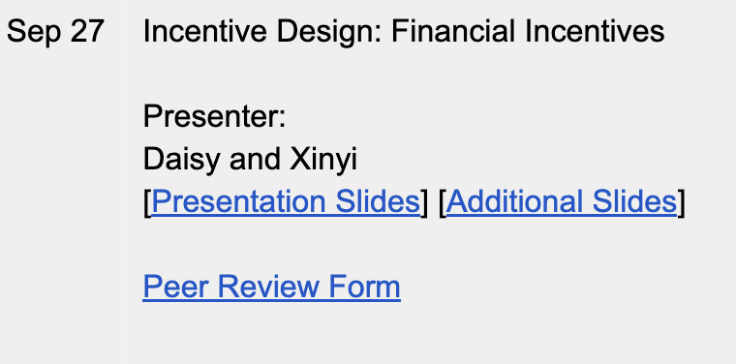
Logistics: Peer Review
The link to the peer review form is on the course website
The comments are not anonymous to me but will be to the presenters
Please try to provide constructive suggestions
Please try to submit them before 6pm
might make sense to get it done during the lecture

Slide 6
Student Presentation

Slide 7
Additional Lecture

Slide 8
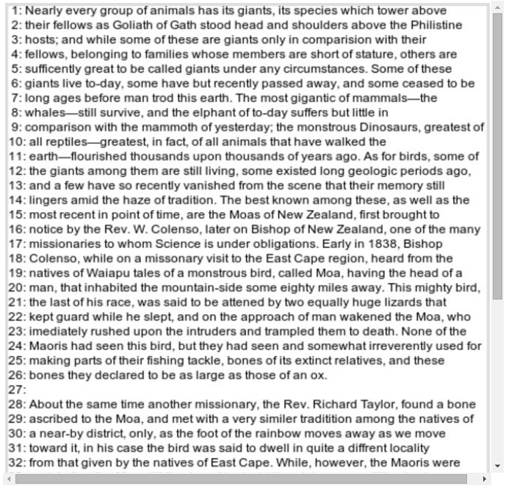
Financial Incentive in Crowdsourcing
Fixed payment
Post a price for the task, workers can choose to accept it or not
Contract: Performance-based payments (PBP)
Proofread this text, earn $0.50
Earn an extra bonus $0.10
for every typo found
Requester’s goal:
Maximize “work quality minus payment”

Slide 9


Static Contract Design
Contract
Task value
Bad Outcome worth $1 | Good Outcome worth $5
$1 | $3
Requester
Payment
Set payments to maximize [expected task value – expected payment]
 | Bad Outcome | Good Outcome
High effort | Prob: 0.1 | Prob: 0.9
Low effort | Prob: 0.8 | Prob: 0.2
Cost: $1
Worker
Cost: $0
Choose effort to maximize [ expected payment – cost ]

Slide 10
Static Contract Design
Contract
Task value
Bad Outcome worth $1 | Good Outcome worth $5
$1 | $3
Requester
Payment
Expected payoff:
$$0.1×\$1+0.9×\$5−0.1×\$1−0.9×\$3=\$1.8$$
expected value – expected payment
 | Bad Outcome | Good Outcome
High effort | Prob: 0.1 | Prob: 0.9
Low effort | Prob: 0.8 | Prob: 0.2
Cost: $1
Worker
Cost: $0
Expected payoff of high effort:
Expected payoff of low effort:
Expected payment - cost

Slide 11
Static Contract Design
Contract
Task value
Bad Outcome worth $1 | Good Outcome worth $5
$1 | $3
Requester
Payment
 | Bad Outcome | Good Outcome
High effort | Prob: 0.1 | Prob: 0.9
Low effort | Prob: 0.8 | Prob: 0.2
Cost: $1
Cost: $0
worker
Contract Design:
How to find the optimal payment that maximizes the requester’s payoff?
In the full information setting, i.e., we know everything about the worker
Well-studied principal-agent problem in economics

Slide 12
Contract Design in Crowdsourcing
Contract
Bad Outcome worth $1 | Good Outcome worth $5
? | ?
Task value
Payment
Requester
Multiple workers
Unknown parameters
Unknown distributions
Interact with one worker at a time
Workers are i.i.d. drawn

Slide 13
Contract Design in Crowdsourcing
Contract
Bad Outcome worth $1 | Good Outcome worth $5
? | ?
Task value
Payment
Requester
Can we adaptively update contracts to maximize the requester’s expected payoff over time
Multiple workers
Unknown parameters
Unknown distributions
Interact with one worker at a time
Workers are i.i.d. drawn

Slide 14


Adaptive Contract Design in Crowdsourcing Markets
joint work with
Alex Slivkins
Microsoft Research, NYC
Jenn Wortman Vaughan
Microsoft Research, NYC
Appeared In ACM EC’14 and JAIR’16

Slide 15
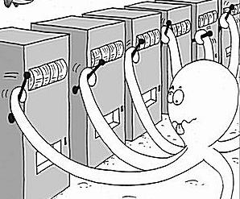
Adaptive Contract Design as A Machine Learning Problem
At each time step
the requester posts a contract
a worker completes the task and returns the result
the requester observes the result and updates the contract
An online learning problem (bandit learning)
exploring the payoff of each contract
exploiting the optimal contract
exploration/exploitation tradeoff
Challenge:
An infinite number of possible contracts (arms)!
Bandits with infinitely many arms

Slide 16
Dealing with Infinitely Many Contracts
Make assumptions on worker behavior
Workers are rational: workers exert effort that maximizes their payments minus costs
Workers are myopic: worker arrive only once and/or won’t try to “game” the system
When posting a PBP (performance-based payments), we learn the payoffs of the posted payment and similar payments

Slide 17
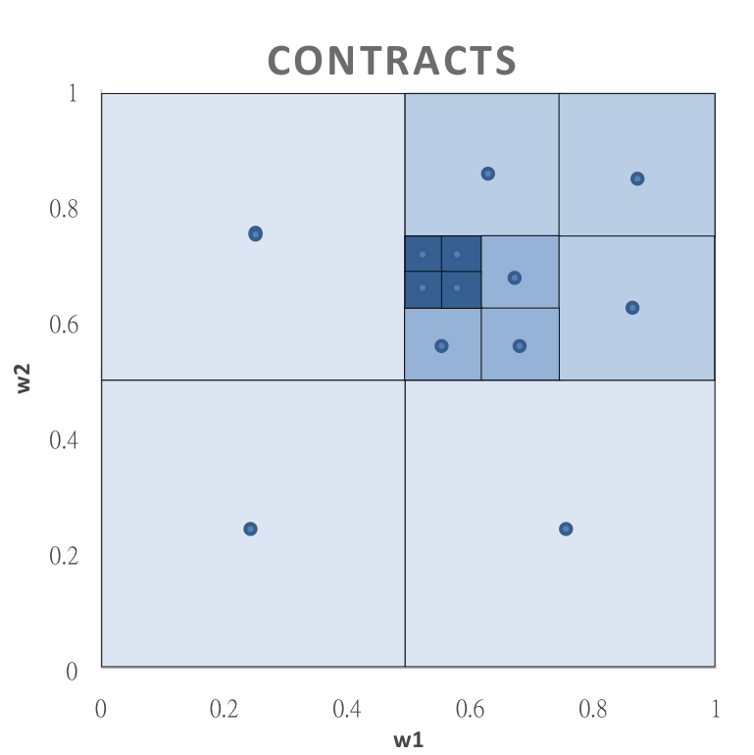
Algorithm and Result
Agnostic Zooming Algorithm:
Adaptively refine the search space and “zoom in” into more promising regions of PBPs
Main theorem If workers are rational and myopic, we can learn the optimal payment efficiently!

Slide 18
Discussion
The two main assumptions made in this paper
Rational: crowd workers want to maximize their payments minus cost
Myopic: crowd workers only care about the payoff “now” at this round
How comfortable are you with these two assumptions? What are the example scenarios these assumptions break? How can you examine empirically that these assumptions hold or not? Are there alternatives for the modeling choices?
Are there other implicit/explicit assumptions out these?

Slide 19
Anchoring effect: Workers’ Perceptions of Fair Payments
When asked how much do they think the payment should be after tasks
X-axis: the payment they receive
Y-axis: the payment they think it should be
Financial Incentives and the "Performance of Crowds”. Mason and Watts. HCOMP 2009.

Slide 20

Incentivizing High Quality Crowdwork
joint work with
Alex Slivkins
Microsoft Research
Sid Suri
Microsoft Research
Jenn Wortman Vaughan
Microsoft Research

Slide 21
Are workers really rational?
Goal: Investigate the casual effects of financial incentives on the quality of crowdwork.

Slide 22
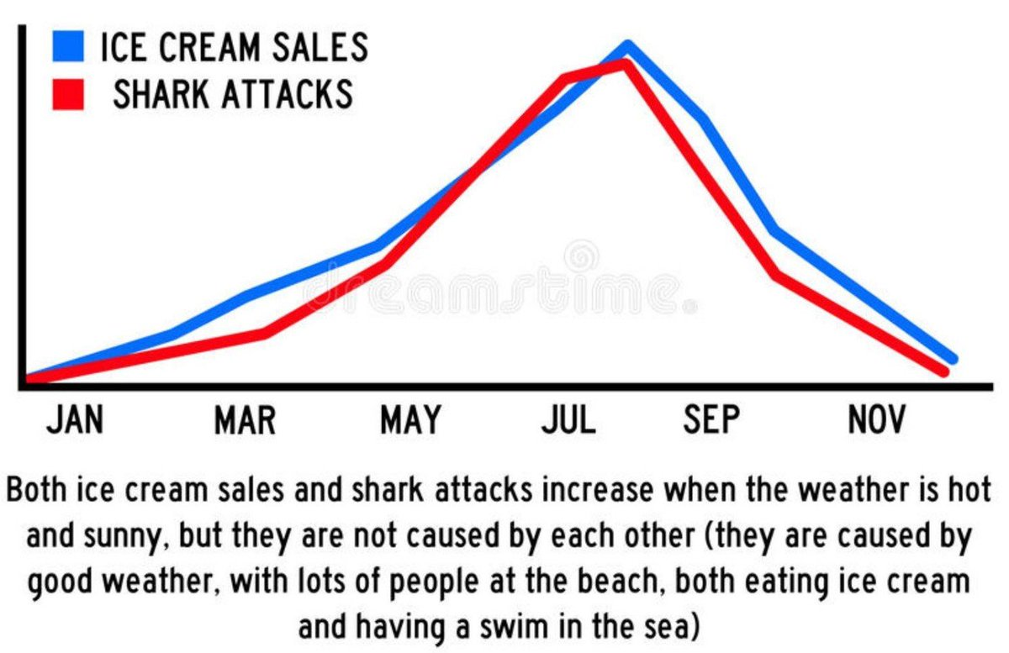
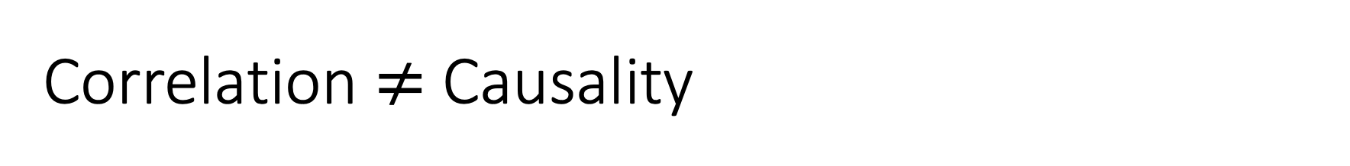
Correlation $≠$ Causality
https://twitter.com/kiabms5/status/1288685777866506240

Slide 23
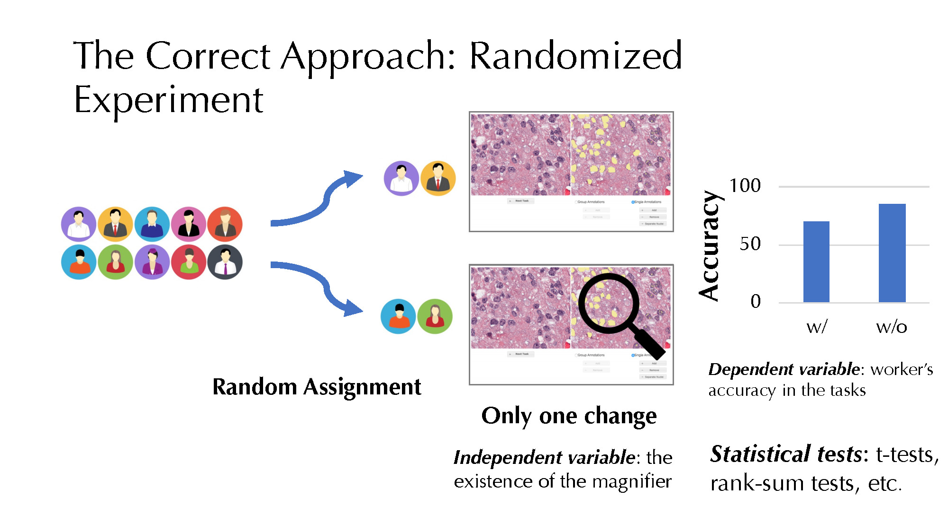
Correlation $≠$ Causality
To infer causality (whether A causes B), randomized experiment is the gold solution at the moment
There have been studies on inferring causality using observational data, but they require some assumptions.

Slide 24
A bit more notes…
How do we know whether a COVID-vaccine works?
Randomized experiments
Control: people receiving placebo
Treatment: people receive the vaccine
Measure their immunity afterwards
Need principled way of conducting the experiments
Pre-registered hypothesis
Don’t peek at the data before it finalizes (or deal with it appropriately)
In the COVID vaccine experiments, a common protocol allows the company to “peek” at the data a few times before the experiment ends, so there is a chance to end the experiment early
Need to take care of this effect in the statistical analysis

Slide 25
From xkcd, by Randall Munroe: http://xkcd.com/882

Slide 26
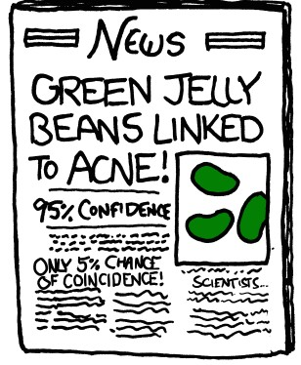
From xkcd, by Randall Munroe: http://xkcd.com/882

Slide 27
Discussion
We have read several papers so far and they have made various assumptions about humans. What assumptions do you think might be questionable (maybe just in some particular applications)?
Can you think of ways to examine the assumption, for example, by designing behavioral experiments or crawling data from the Web for analysis?

